Slide 1

Wearables: other functional approaches
JSM 2019

Slide 2
Overview
Multi-level functional methods
Matrix-variate multi-level functional methods
Multi-level methods for generalized (e.g binary) functional curves
Registration of generalized (e.g. binary) functional curves

Slide 3
Multi-level functional principal component analysis (MFPCA)

Slide 4
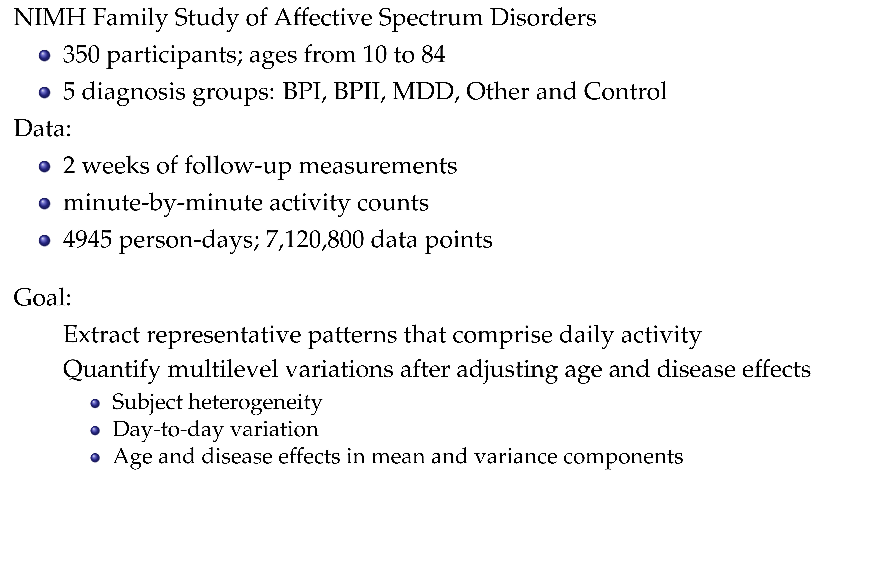

Slide 5
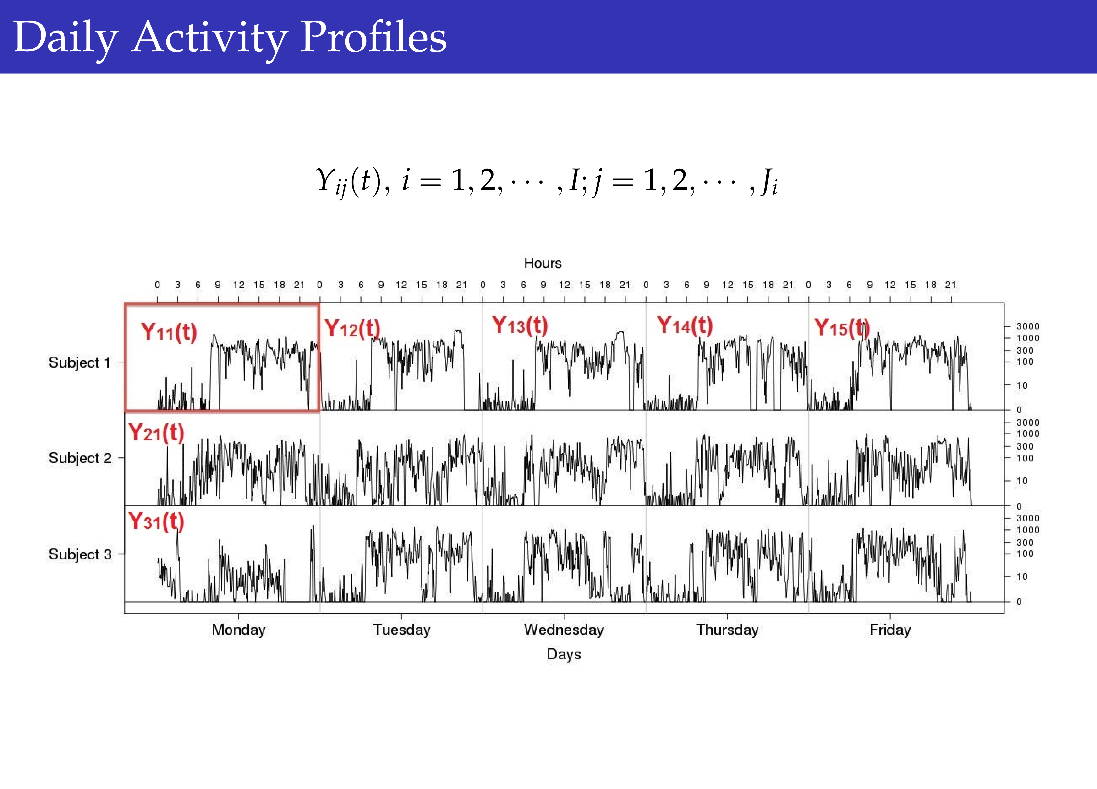

Slide 6
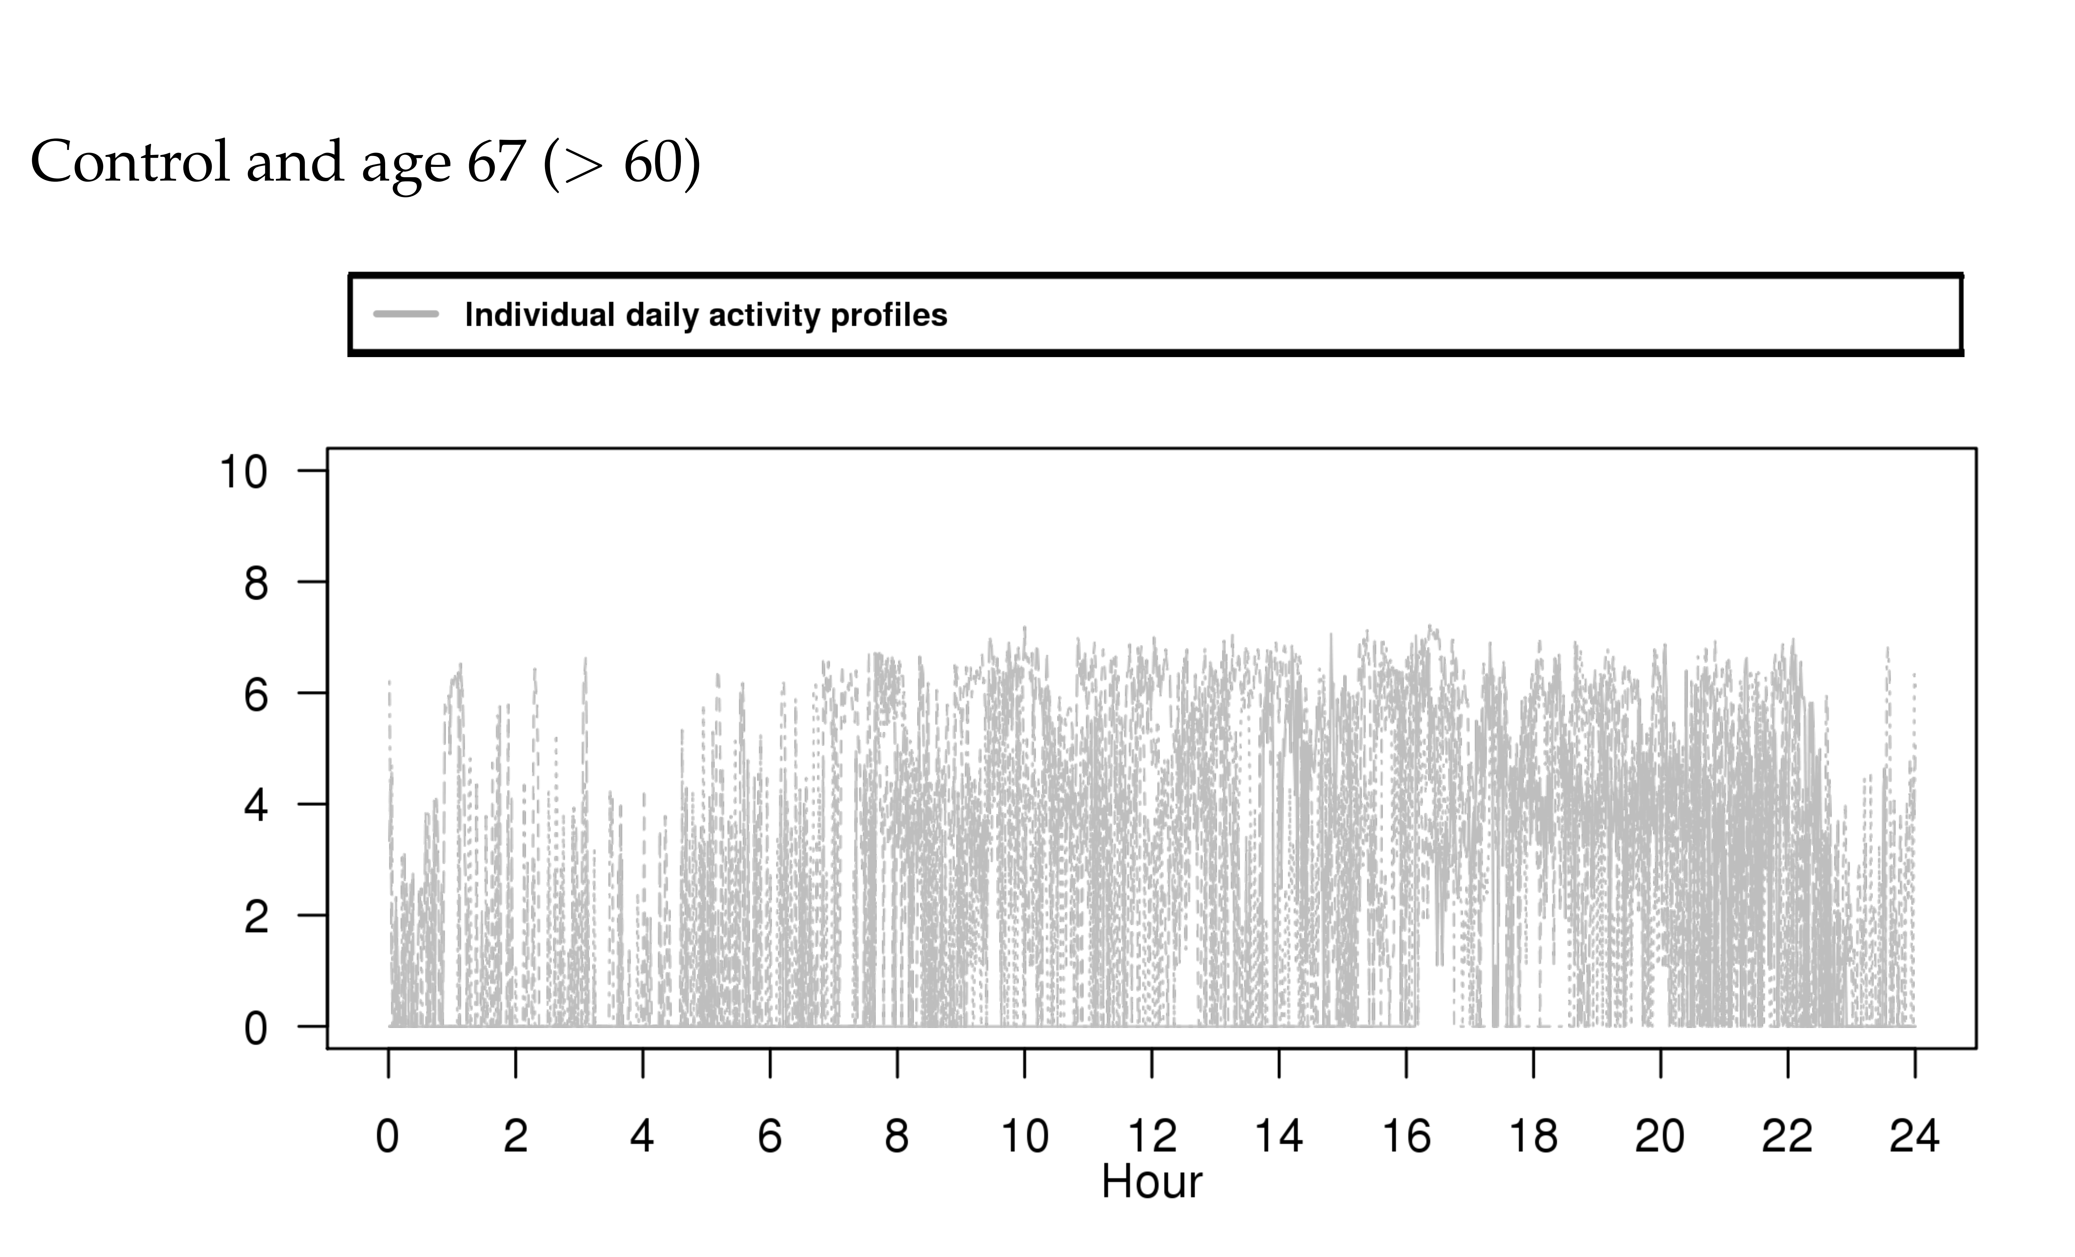

Slide 7
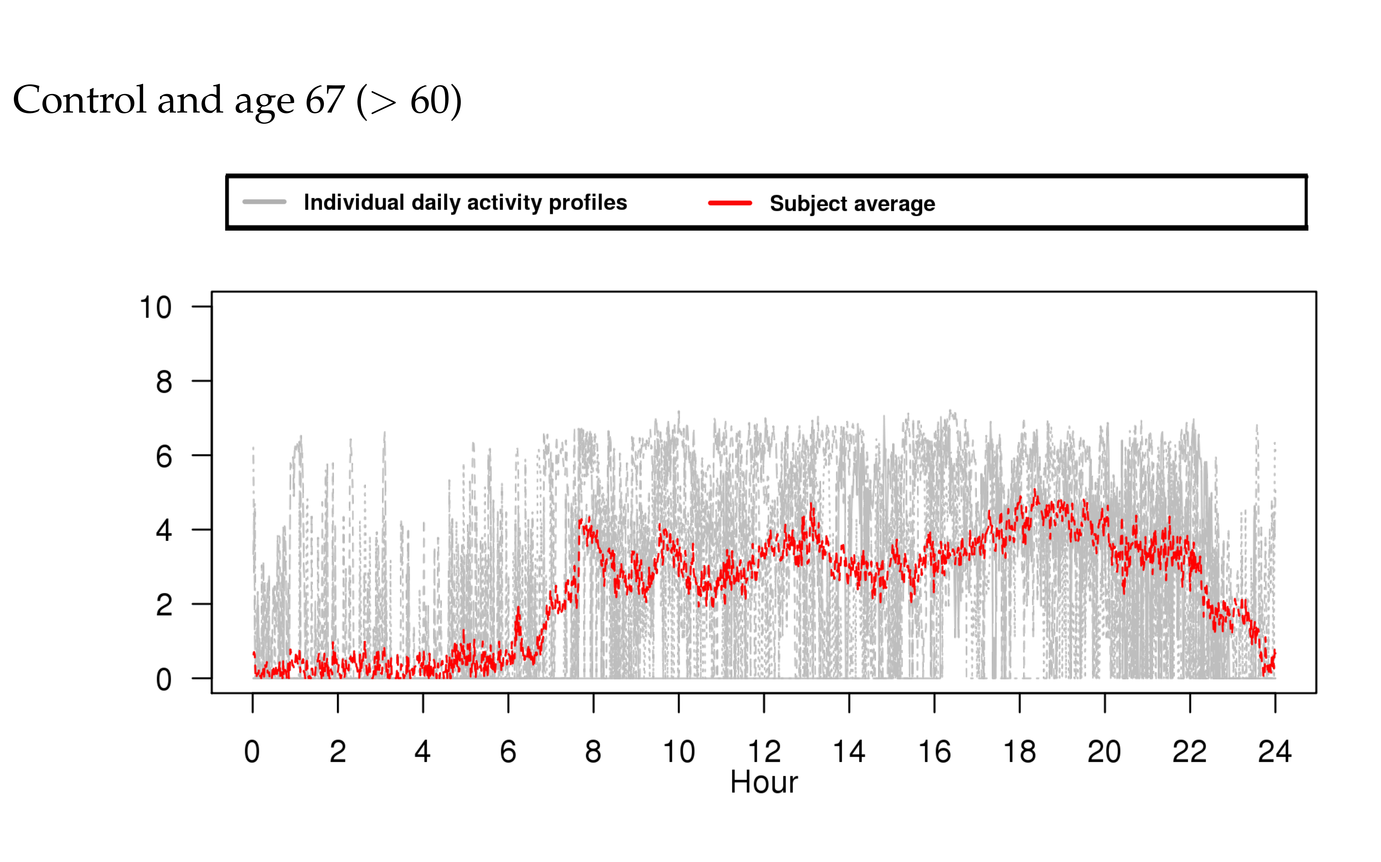

Slide 8
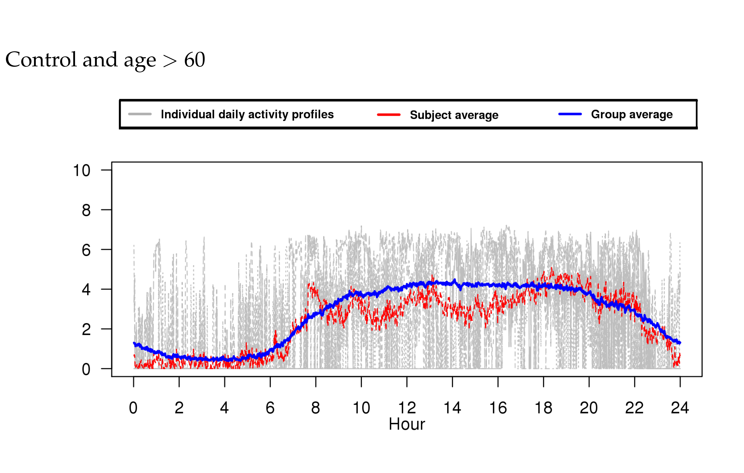

Slide 9
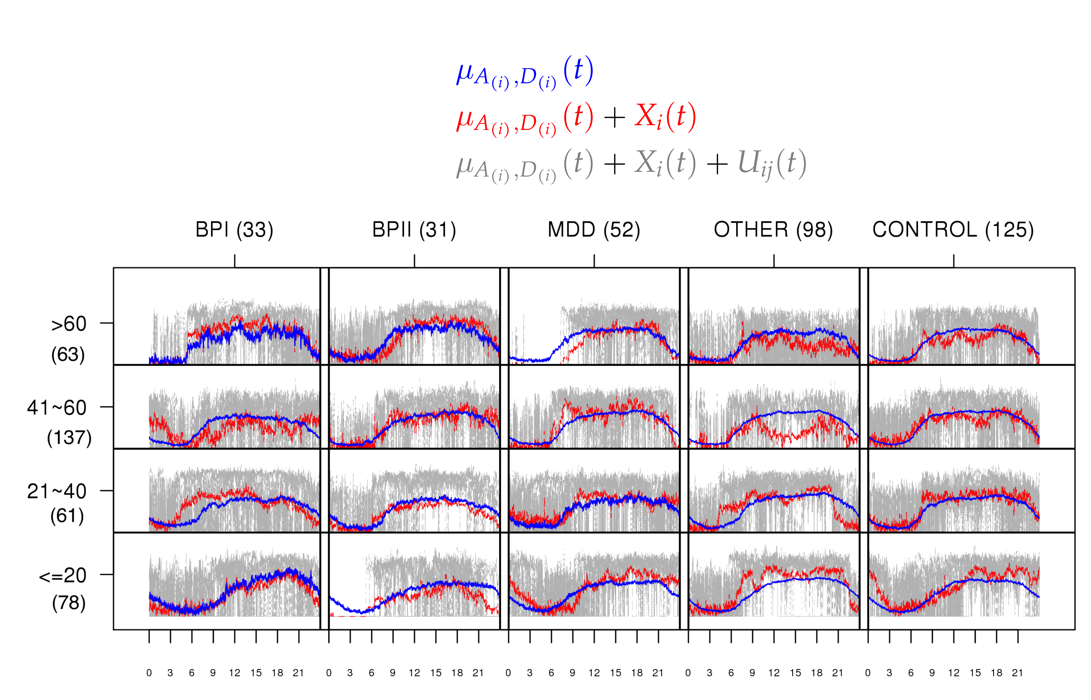

Slide 10
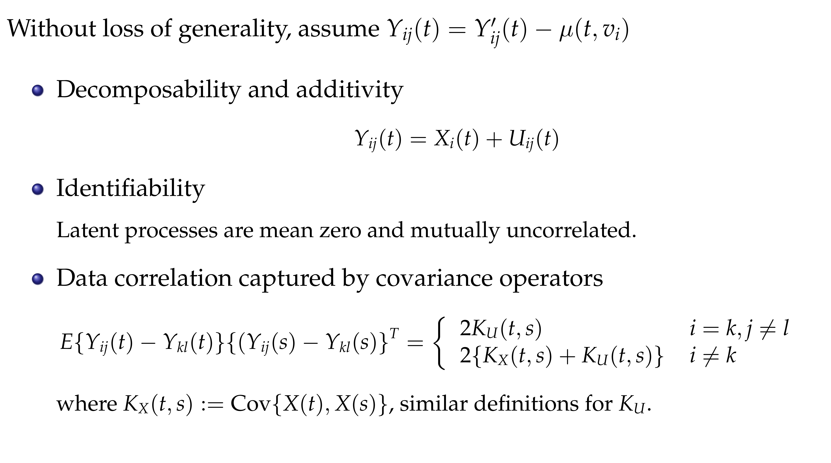

Slide 11
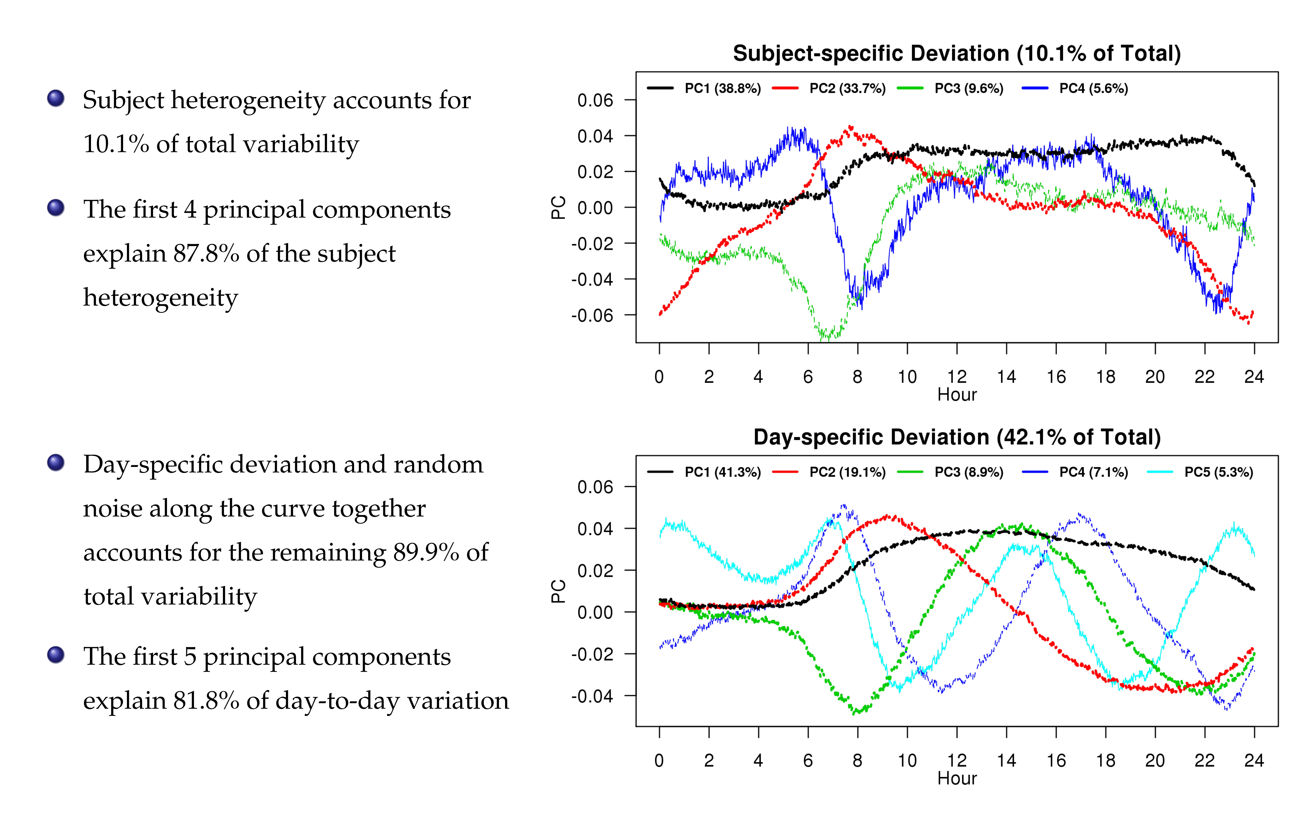

Slide 12
References
Di, C.Z., Crainiceanu, C.M., Caffo, B.S. and Punjabi, N.M., 2009. Multilevel functional principal component analysis. The annals of applied statistics, 3(1), p.458.
Zipunnikov V., Caffo B.S., Yousem D.M, Davatzikos C., Schwartz B.S., Crainiceanu C. (2011),Multilevel Functional Principal Component Analysis for High-Dimensional Data. Journal of Computational and Graphical Statistics, 20(4), pp. 852-873
Shou, H., Zipunnikov, V., Crainiceanu C., Greven, S. (2015) Structured Functional Principal Component Analysis Biometrics, 71 (1), pp. 247-757

Slide 13
Multi-level Matrix-Variate Analysis (MMVA)

Slide 14
Background
Heart failure (HF) is a leading chronic disease in the elderly
Lifetime risk is 20% for those over age 40 in the US
HF burden exceeds $30 billion (> 50% on hospitalization costs)
Identifying subjects with increased risk of hospitalization is important

Slide 15
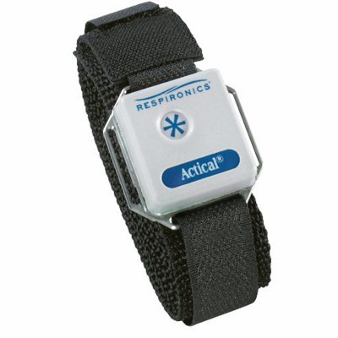
Background
Static risk models include demographics, comorbidities (AFib, hypertension, diabetes mellitus), income, etc.
Dynamic risk models may be more accurate by including real-time data from wearables
A prospective longitudinal cohort study Advanced Cardiac Care Center of Columbia University Medical Center
59 individuals with clinical diagnosis of congestive heart failure (CHF)
3-9 months of follow up
Actical (Respironics)
up to one month of minute-level activity counts

Slide 16
Background
24 individuals had adverse clinical events
14 hospitalizations
10 emergency room visits
Goal: model within-subject pre/post event change in patients status
Solution: track week-to-week variability

Slide 17
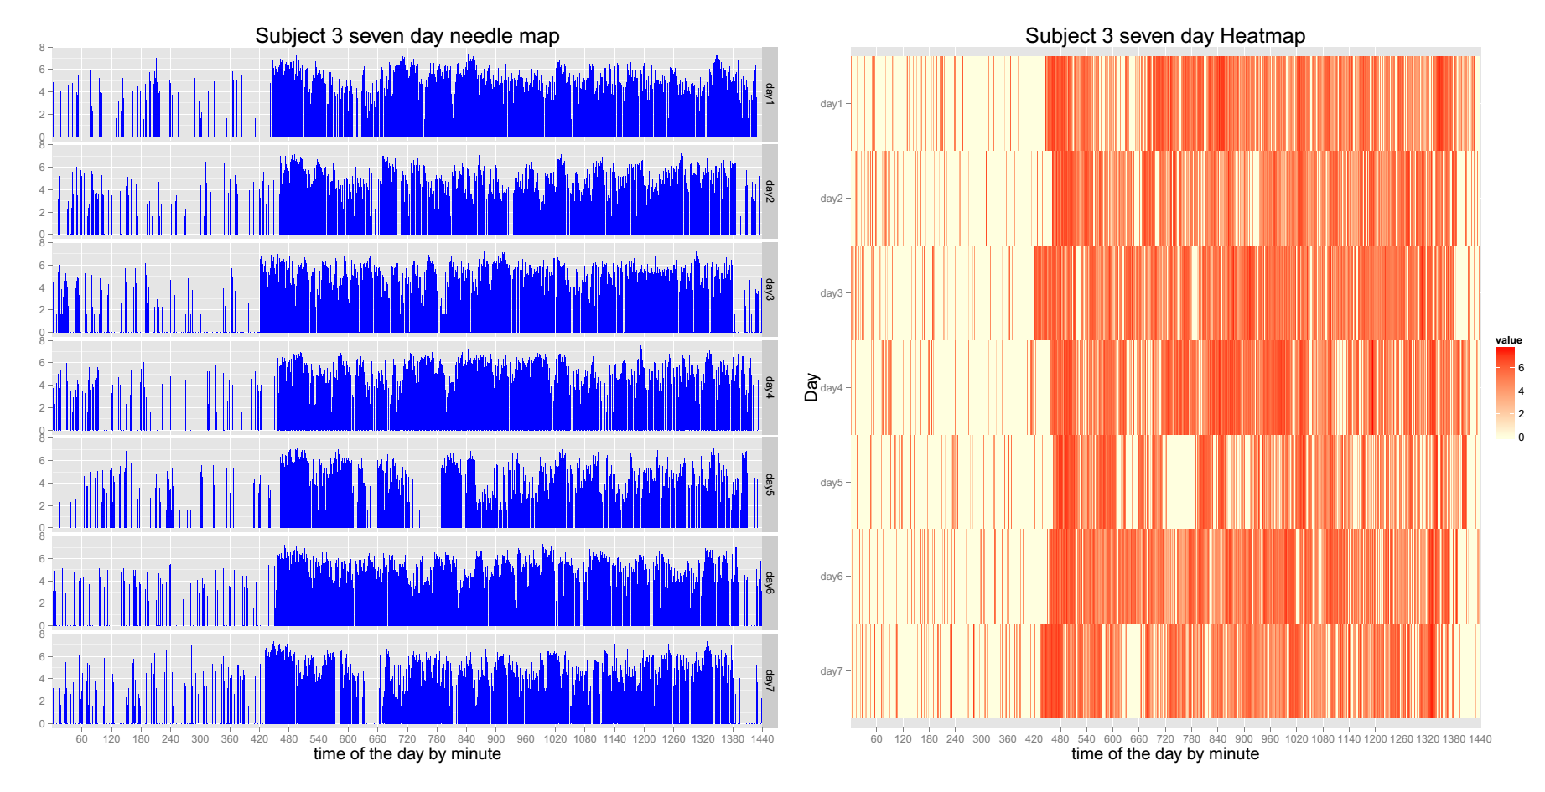
Minute-level activity profiles

Slide 18
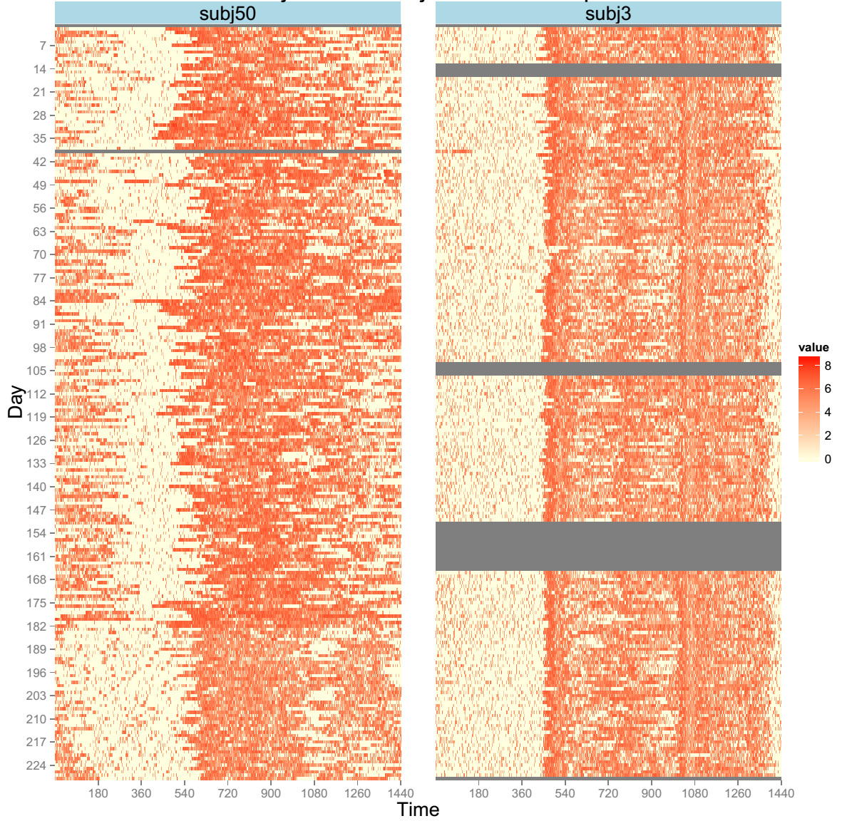
No-event group subject
- 8 months of monitoring
Low week-to-week variability
Had no hospitalizations
Notes:
Aim: to quantify the week to week variability

Slide 19
Event-group subject
- 8 months of monitoring
High week-to-week variability
Had a hospitalization
Notes:
Aim: to quantify the week to week variability

Slide 20
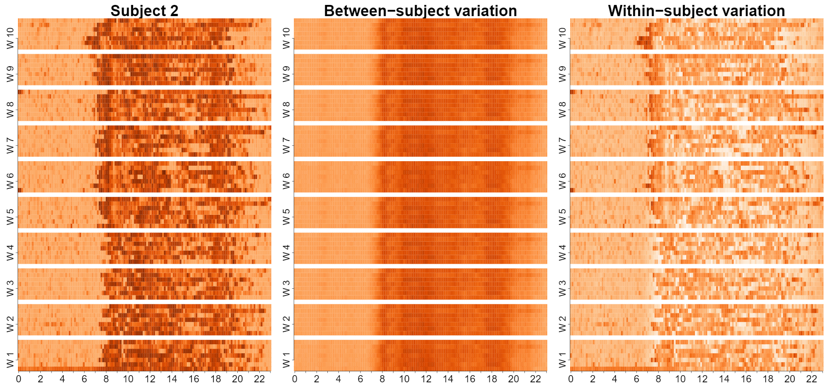
Multilevel Matrix-Variate Analysis (MMVA)
Keep within-week temporal structure across days & within-day
Models subject-specific week-to-week variability
uses a linear mixed effect model to account for the multilevel design
2D structure is handled via a matrix-variate distribution
Notes:
Give some background on NHANES, day of the week and the time of the day;

Slide 21
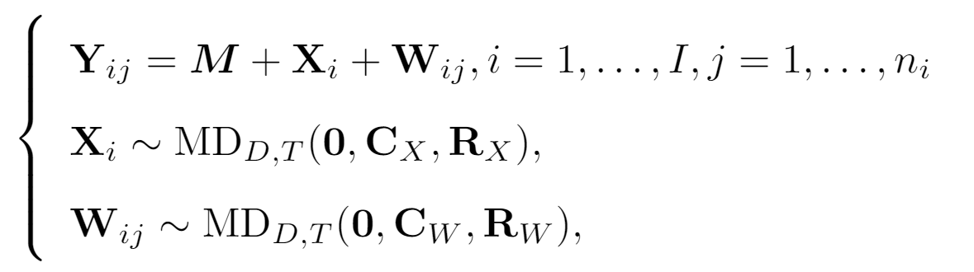
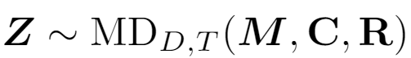
MMVA
Model:
Z follows a matrix-variate distribution:
if
Normal matrix-variate distribution
Notes:
Add things about representing in terms of the basis

Slide 22
MMVA
Between-subject matrix-variate distance
Within-subject matrix-variate distance

Slide 23
MMVA
Between-subject scores can be used as a “static” biomarker to enrich and potentially improve accuracy of currently used “static" risk score models.

Slide 24
MMVA
Within-subject scores can be used as “dynamic” biomarkers that inform about weekly changes in patient status.

Slide 25
Reference
Huang, L., Bai, J., Ivanescu, A., Harris, T., Maurer, M., Green, P. and Zipunnikov, V., 2019. Multilevel matrix-variate analysis and its application to accelerometry-measured physical activity in clinical populations. Journal of the American Statistical Association, 114(526), pp.553-564.
Data is freely available with the submission

Slide 26
Multi-level Generalized Function-on-Scalar Regression and Principal Component Analysis

Slide 27
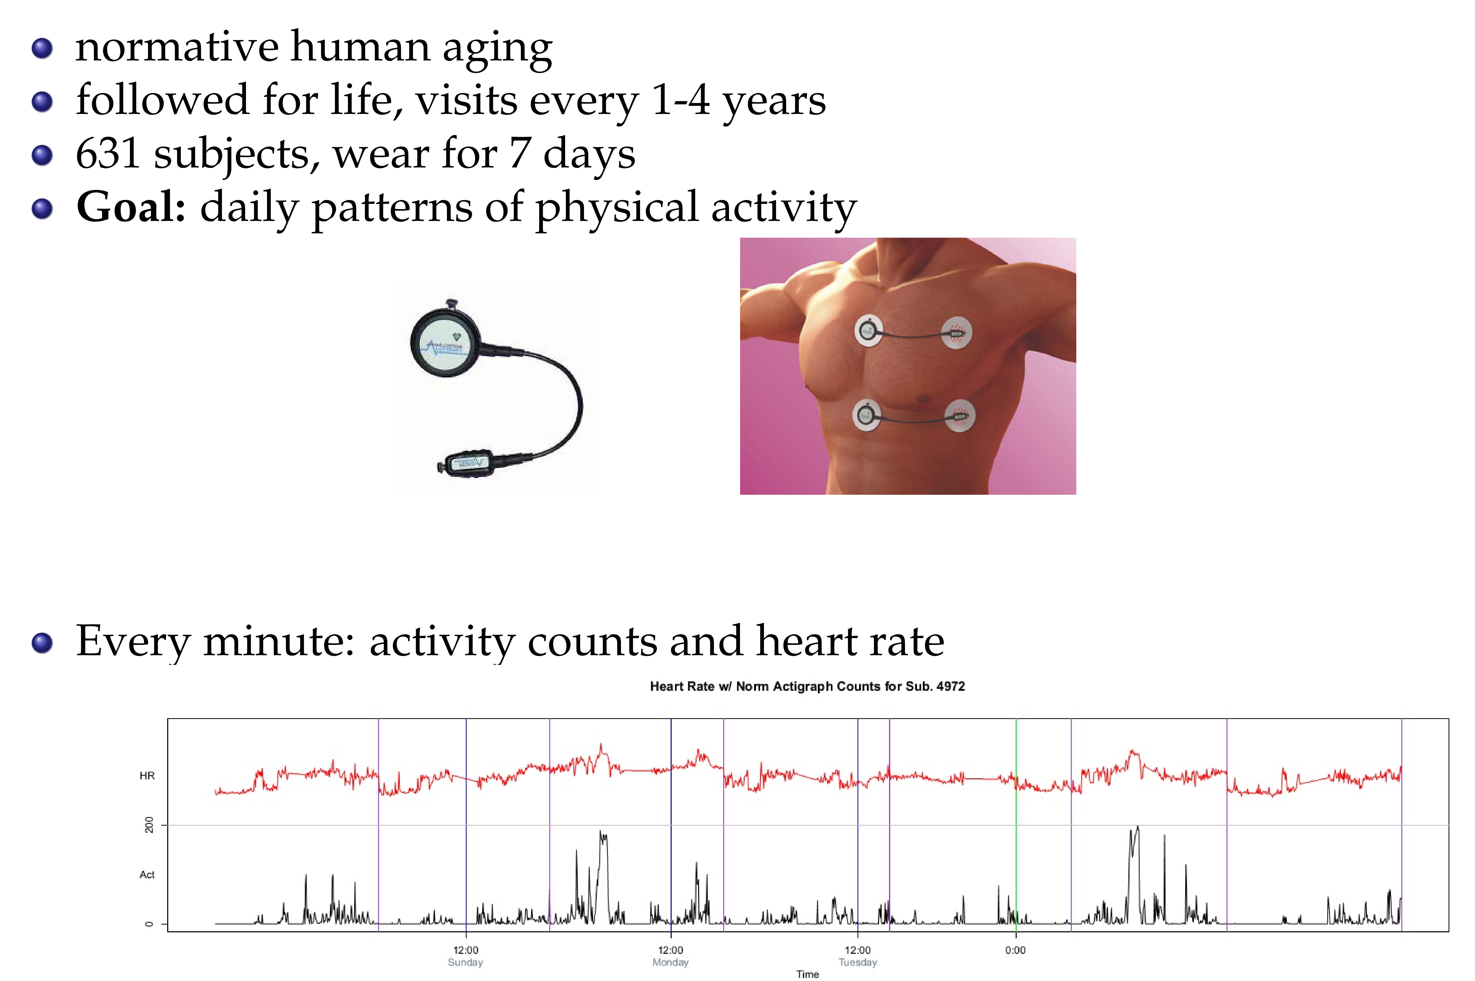

Slide 28
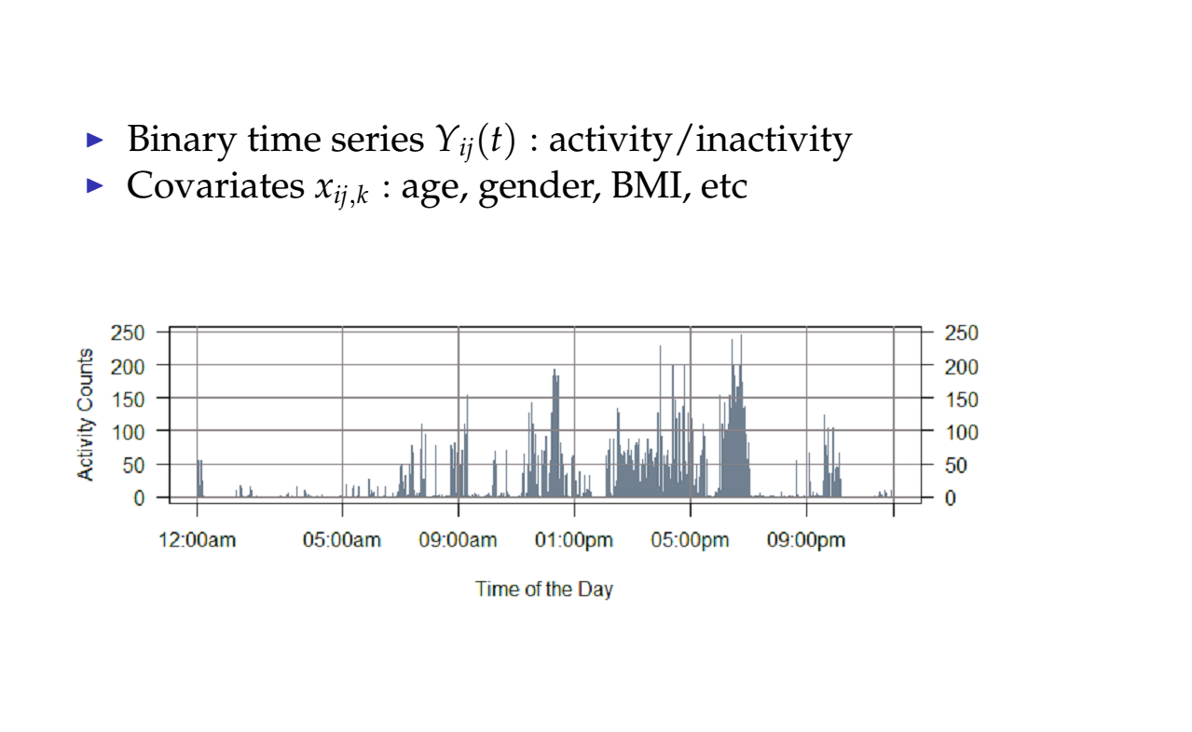

Slide 29
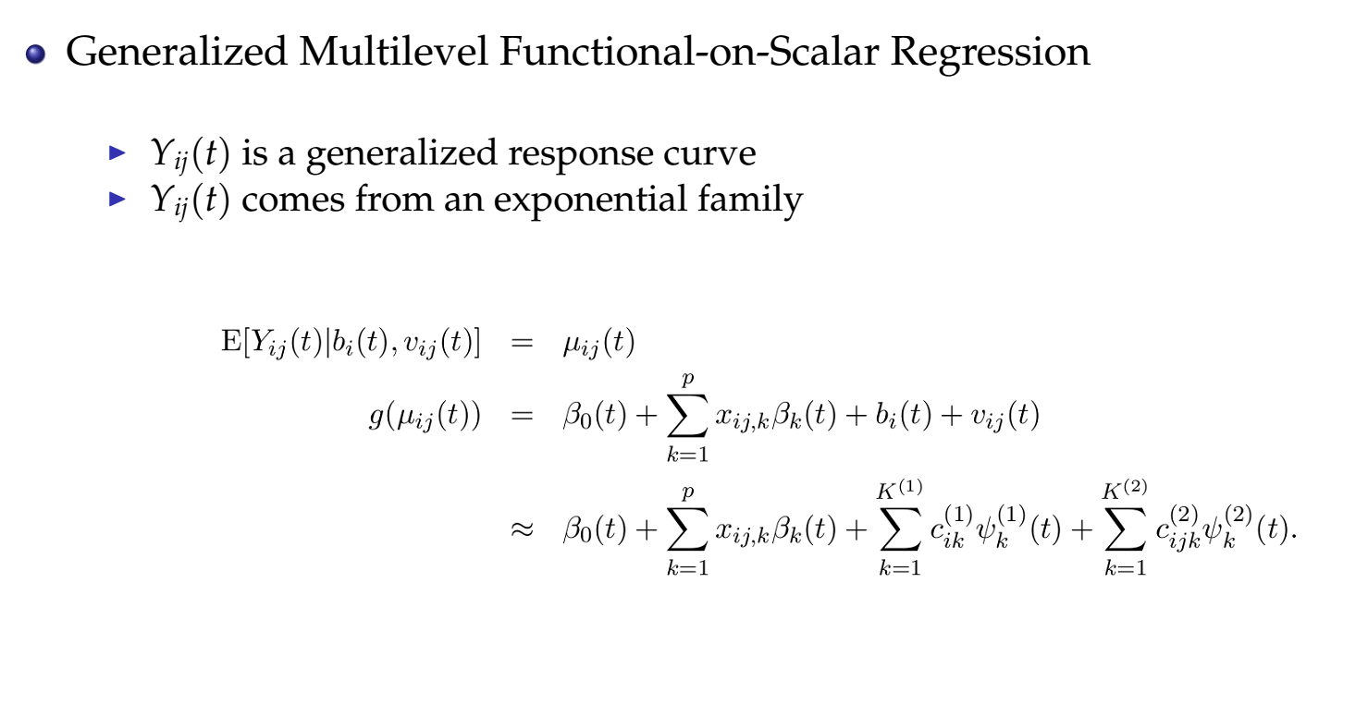

Slide 30
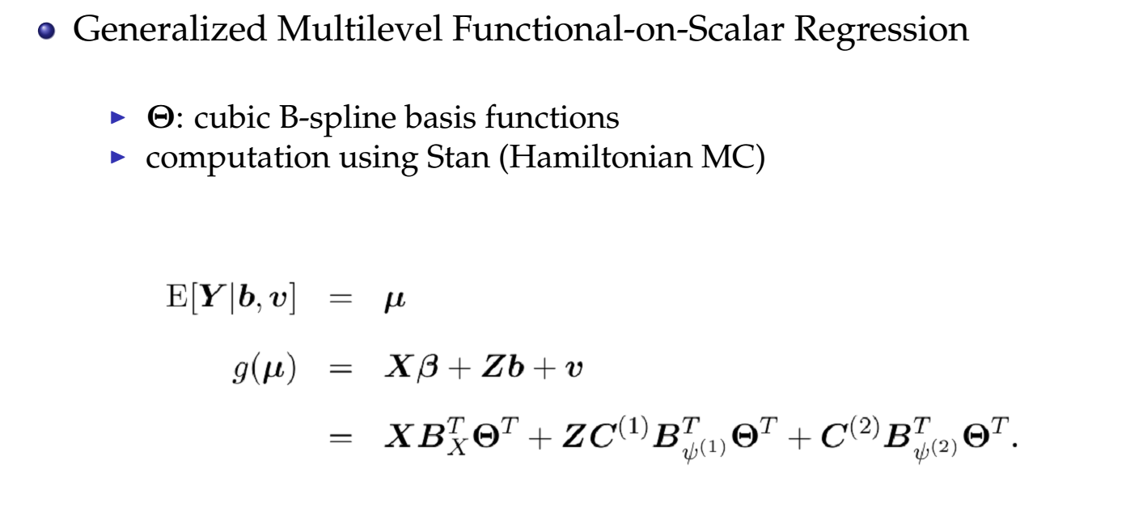

Slide 31
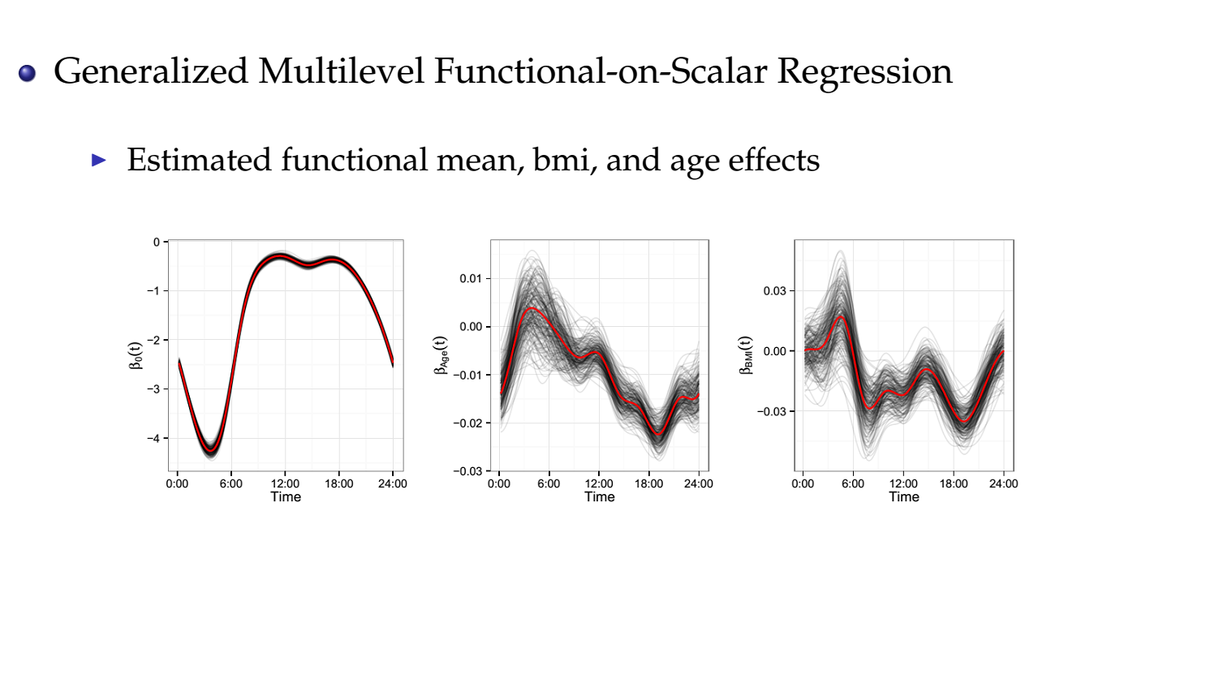

Slide 32
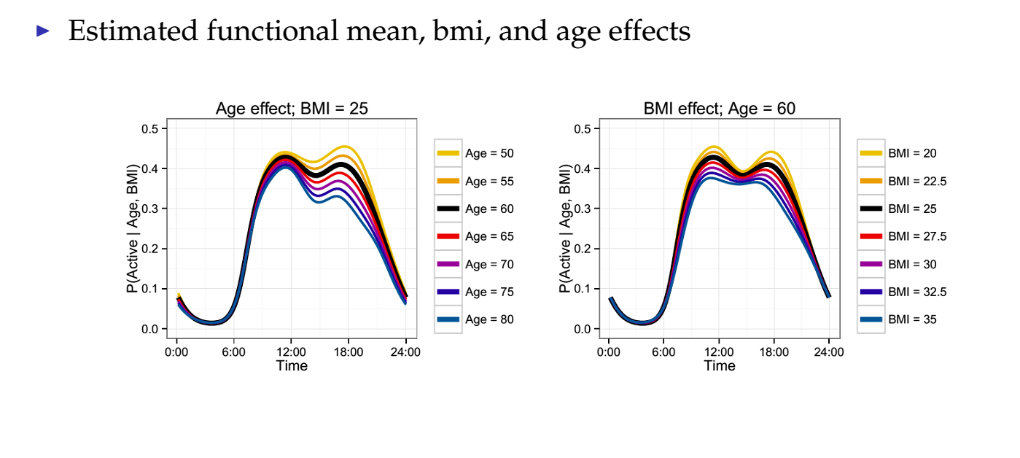

Slide 33
References:
Goldsmith, J., Zipunnikov, V, Schrack, J., Generalized Multilevel Function-on-Scalar Regression and Principal Component Analysis Biometrics, 71 (2), pp. 344-353

Slide 34
Registration of binary (0/1) actigraphy profiles

Slide 35
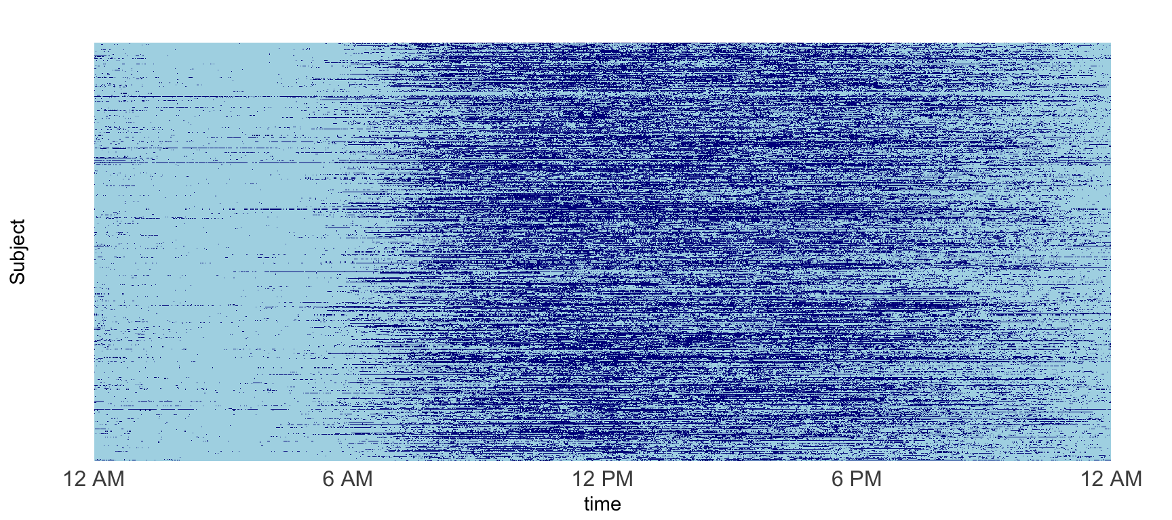
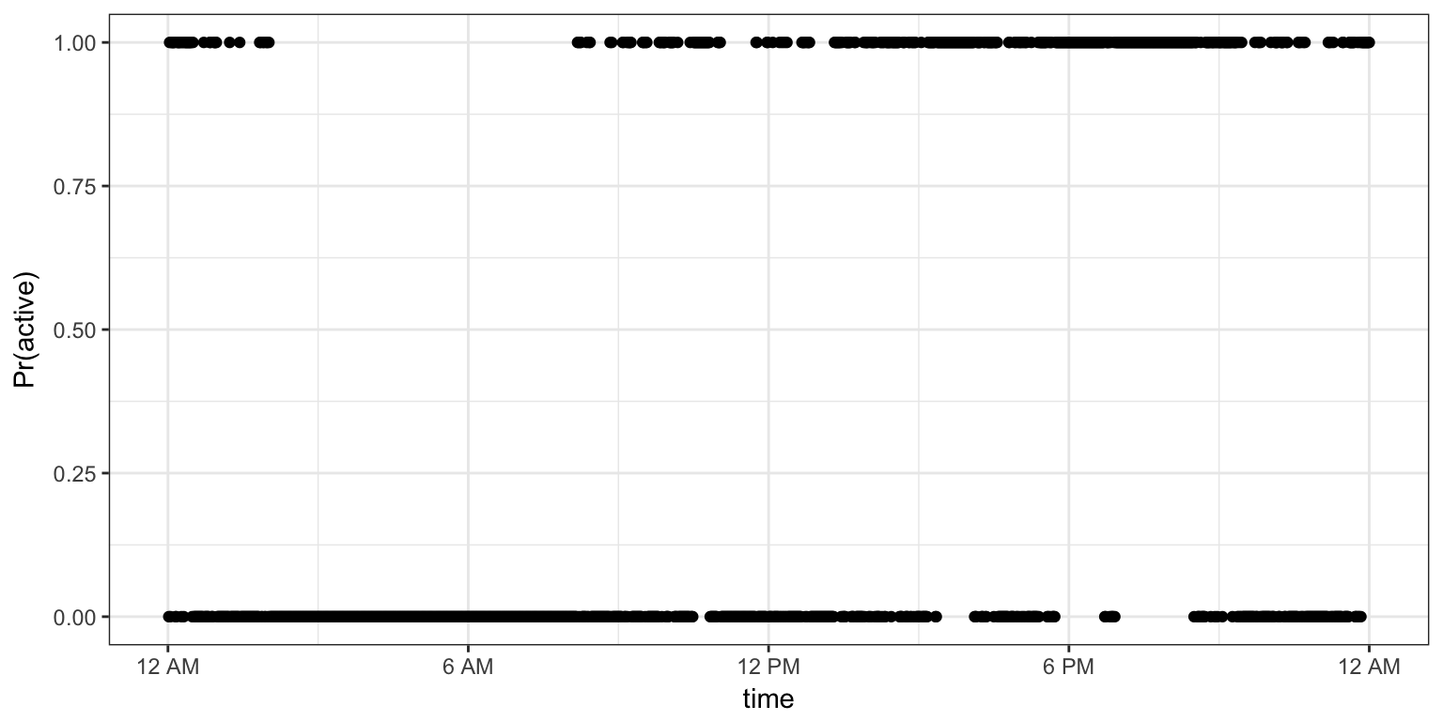
Binary “activity”

Slide 36
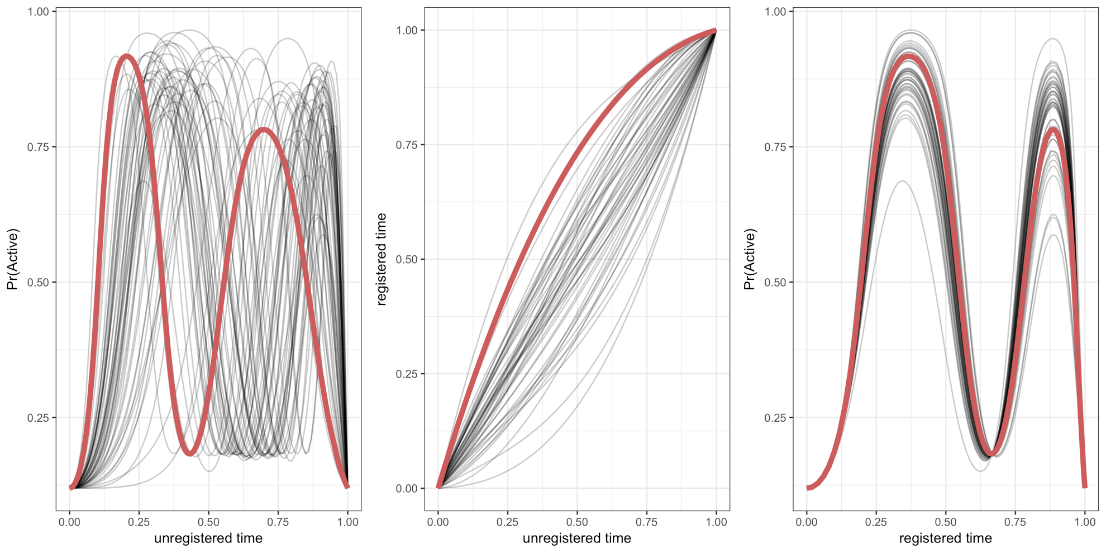
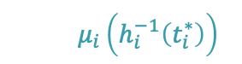
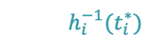
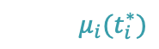
Registration
$$μ_{i}(t_{i}^{∗})$$
$$h_{i}^{−1}(t_{i}^{∗})$$
$$μ_{i}\left(h_{i}^{−1}\left(t_{i}^{∗}\right)\right)$$
Notes:
- Highlight one persons warping function, curves pre and post registration

Slide 37
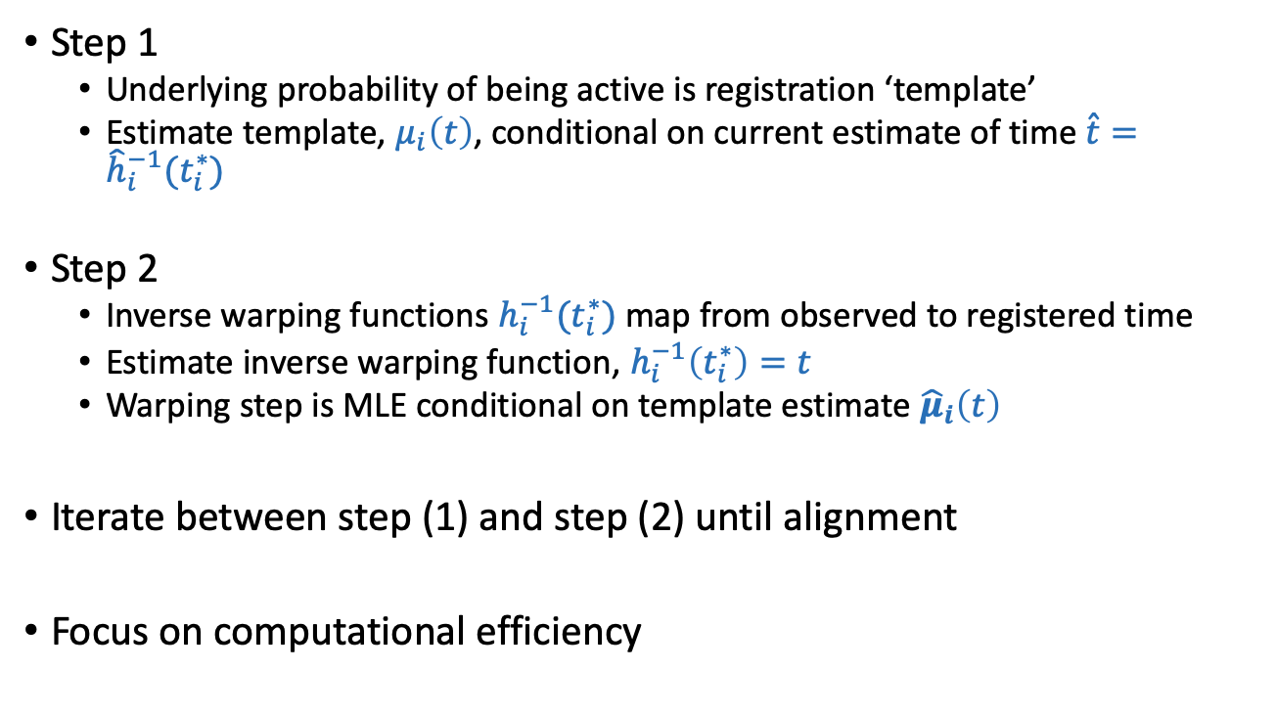
Exponential family registration
Step 1
Underlying probability of being active is registration ‘template’
Estimate template, $μ_{i}\left(t\right)$, conditional on current estimate of time $\hat{t}={\hat{h}}_{i}^{−1}(t_{i}^{∗})$
Step 2
Inverse warping functions $h_{i}^{−1}(t_{i}^{∗})$ map from observed to registered time
Estimate inverse warping function, $h_{i}^{−1}\left(t_{i}^{∗}\right)=t$
Warping step is MLE conditional on template estimate ${\hat{μ}}_{i}\left(t\right)$
Iterate between step (1) and step (2) until alignment
Focus on computational efficiency

Slide 38
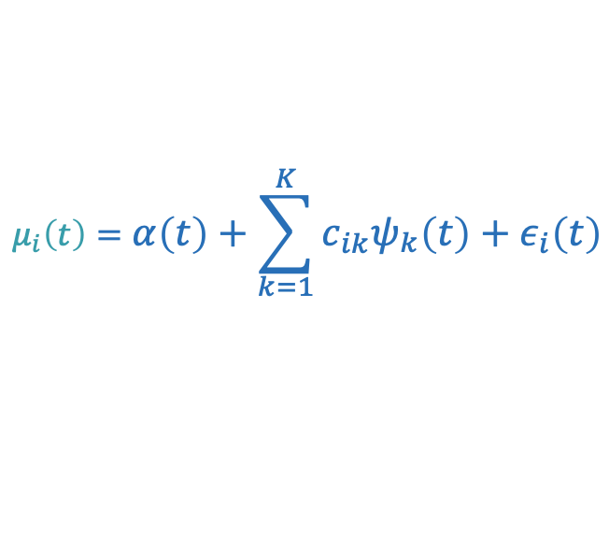
FPCA
Small digression …
FPCA is a variation on PCA that involves smoothness in eigenfunctions
Most often, the process is to
Compute a covariance from observed data vectors
Smooth the covariance, after removing off-diagonal elements
Decompose resulting covariance matrix to obtain eigenfunctions (vectors) and score variances
Scores are estimated in a mixed model
$$μ_{i}\left(t\right)=α\left(t\right)+\sum_{k=1}^{K}{c_{ik}ψ_{k}\left(t\right)}+ε_{i}\left(t\right)$$
Notes:
Explain PCA
Explain FPCA
Ideal for this type of problem
Our algorithm is fast

Slide 39

Probabilistic (F)PCA
Probabilistic / Bayesian methods provide an alternative to the usual covariance decomposition approach
Model is of interest is still
Add priors for the mean and eigenfunctions (vectors)
MLE is equivalent, up to rotation, to the covariance decomposition method
$$μ_{i}\left(t\right)=α\left(t\right)+\sum_{k=1}^{K}{c_{ik}ψ_{k}\left(t\right)}+ε_{i}\left(t\right)$$
Notes:
Explain PCA
Explain FPCA
Ideal for this type of problem
Our algorithm is fast

Slide 40
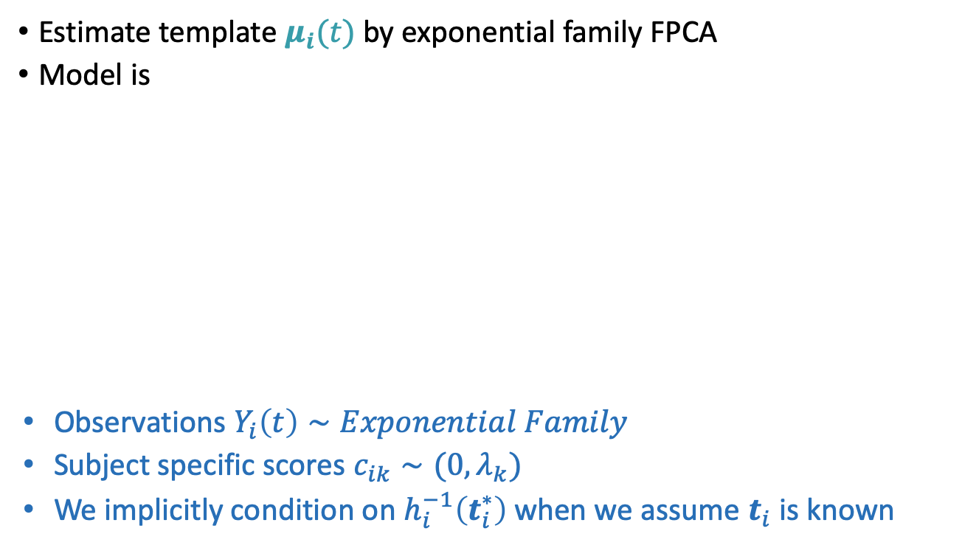
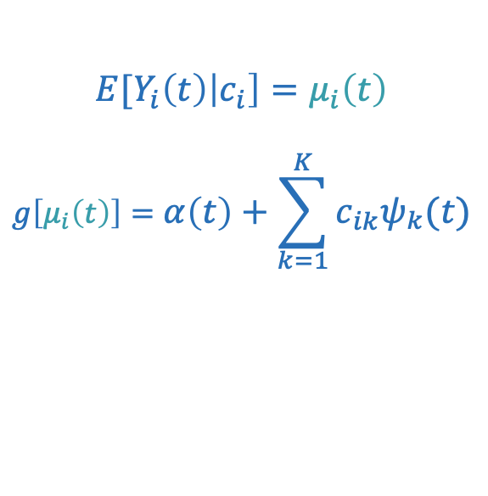
Back to registration – Step 1
Estimate template $μ_{i}(t)$ by exponential family FPCA
Model is
Observations $Y_{i}\left(t\right)∼Exponential Family$
Subject specific scores $c_{ik}∼(0, λ_{k})$
We implicitly condition on $h_{i}^{−1}\left(t_{i}^{∗}\right)$ when we assume $t_{i}$ is known
$${E[Y}_{i}\left(t\right)\left|c_{i}\right]=μ_{i}\left(t\right)$$
$$g\left[μ_{i}\left(t\right)\right]=α\left(t\right)+\sum_{k=1}^{K}{c_{ik}ψ_{k}(t)}$$
Notes:
Explain PCA
Explain FPCA
Ideal for this type of problem
Our algorithm is fast

Slide 41
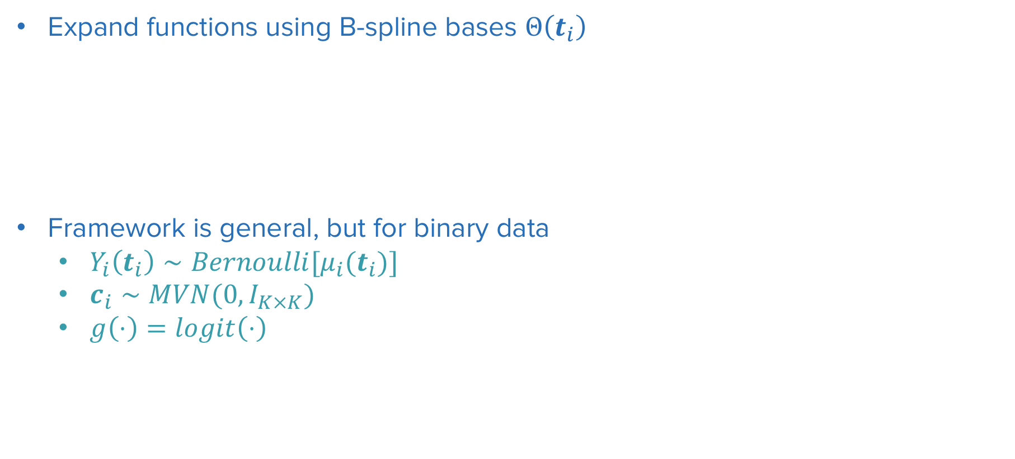
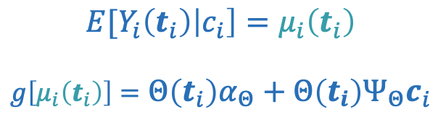
Exponential-family FPCA
Expand functions using B-spline bases $Θ\left(t_{i}\right)$
Framework is general, but for binary data
$Y_{i}\left(t_{i}\right)∼Bernoulli[μ_{i}(t_{i})]$
$c_{i}∼MVN(0, I_{K×K})$
$g\left(⋅\right)=logit\left(⋅\right)$
$${E[Y}_{i}\left(t_{i}\right)\left|c_{i}\right]=μ_{i}\left(t_{i}\right)$$
$$g\left[μ_{i}\left(t_{i}\right)\right]=Θ\left(t_{i}\right)α_{Θ}+Θ\left(t_{i}\right)Ψ_{Θ}c_{i}$$
Notes:
Explain PCA
Explain FPCA
Ideal for this type of problem
Our algorithm is fast

Slide 42
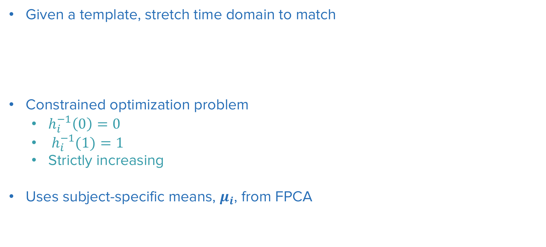
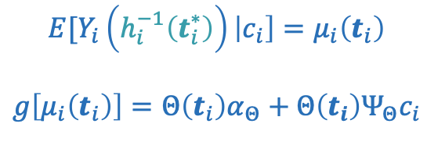

Registration Step 2: Estimate $h_{i}^{−1}\left(t_{i}^{∗}\right)$
Given a template, stretch time domain to match
Constrained optimization problem
$h_{i}^{−1}\left(0\right)=0$
${ h}_{i}^{−1}(1)=1$
Strictly increasing
Uses subject-specific means, $μ_{i}$, from FPCA
$${E[Y}_{i}\left(h_{i}^{−1}\left(t_{i}^{∗}\right)\right)\left|c_{i}\right]=μ_{i}\left(t_{i}\right)$$
$$g\left[μ_{i}\left(t_{i}\right)\right]=Θ\left(t_{i}\right)α_{Θ}+Θ\left(t_{i}\right)Ψ_{Θ}c_{i}$$
Notes:
Remind people of where you are in your talk

Slide 43


Implementation
Fast Binary FPCA (C++ backend)
Constrained optimization with known gradient in constrOptim()
R package registr
refund.shiny plotting
tidyfun integration coming soon!

Slide 44
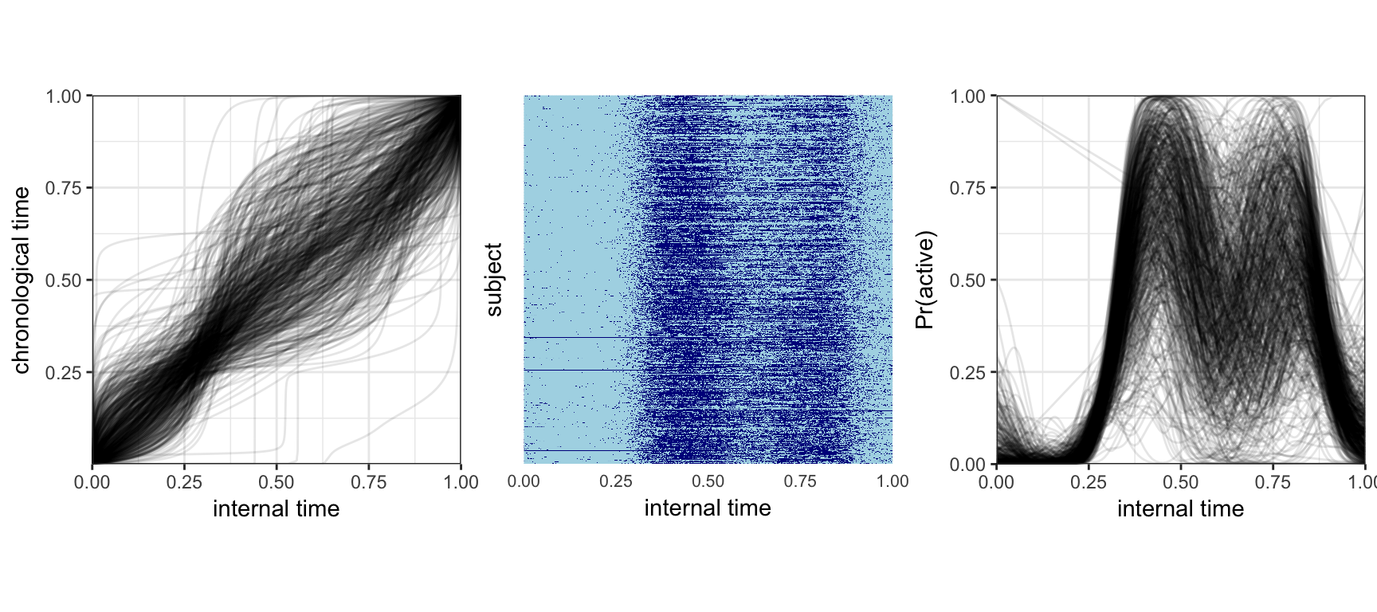
BLSA – post-registration

Slide 45
References:
Wrobel, J., Zipunnikov, V., Schrack, J. and Goldsmith, J., 2019. Registration for exponential family functional data. Biometrics, 75(1), pp.48-57.

